Slide 1
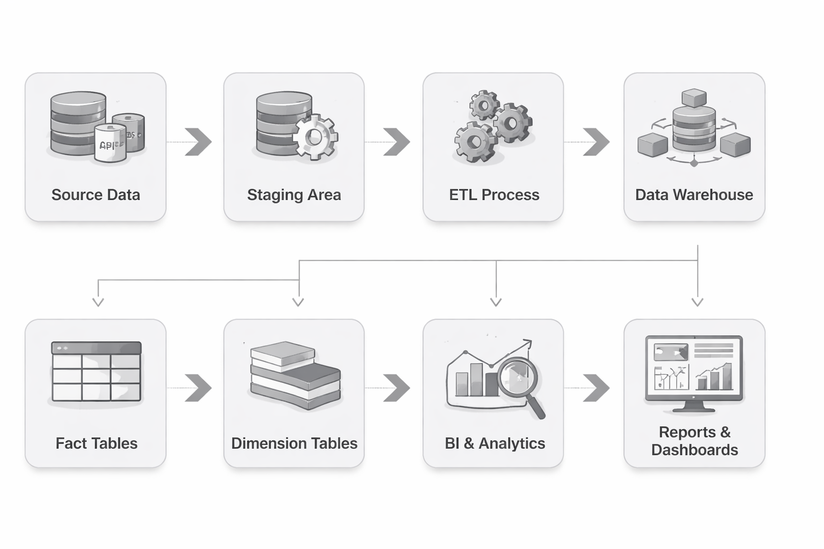
DATA WAREHOUSE DESIGN AND ETL OPTIMIZATION FOR ENTERPRISE BUSINESS INTELLIGENCE

Slide 2
Abstract
This project develops an optimized ETL pipeline and enterprise data warehouse (EDW) for a business analytics scenario. We use Python scripts to extract and transform raw operational data (e.g. sales records) and load it into a star-schema warehouse on SQL Server. The warehouse enables high-speed OLAP queries and feeds interactive Power BI dashboards. Without such an EDW, running complex analytics directly on OLTP systems can be costly and slow, as ETL processes are “time-consuming and complicated” without optimization. Our approach significantly improves query performance and data freshness by offloading analytics to the warehouse (as demonstrated in a sample e-commerce sales use case).

Slide 3
Objectives
Clean and prepare raw data for analysis (e.g. filter invalid transactions, normalise fields).
Design a dimensional model (star schema) in SQL Server to support analytics.
Implement a Python-based ETL pipeline to extract, transform, and load data into the warehouse.
Optimise ETL and database performance (e.g. parallel loads, indexing) for large data volumes.
Develop Power BI dashboards to visualise KPIs (sales trends, conversion funnels, etc.) for end-user insights.

Slide 4
Software Requirements
Python 3.x (with libraries like Pandas, SQLAlchemy) for ETL scripting.
Microsoft SQL Server (Developer/Express edition) as the data warehouse database.
Power BI Desktop/Service for building dashboards and reports.
Additional Tools: Windows OS (for SQL Server), Git (version control), and any ODBC drivers for data

Slide 5
Hardware Requirements
CPU: x64 processor ≥ 2.0 GHz (multi-core recommended).
Memory: ≥ 4 GB RAM (8+ GB recommended for smooth ETL and BI workloads).
Storage: ~100 GB SSD (for OS, SQL data files, and logs; SQL Server needs ~6 GB min).
Other: Gigabit Ethernet (for data transfers), modern GPU optional (for Power BI visuals).

Slide 6
Existing System (OLTP Only)
Performance issues: OLTP databases optimize short transactions, so complex analytic queries on them will slow the system and hurt transaction throughput.
Data silos: Business data often resides in multiple OLTP systems (ERP, CRM, etc.); there is no single, integrated data view for reporting.
Limited history: OLTP schemas store current state, not long-term history. Analysts cannot easily trend or aggregate past data.
Manual reporting: Without a data warehouse, reporting requires expensive ad-hoc queries or data dumps, making business intelligence development slow and error-prone.

Slide 7
Proposed System (ETL + DWH + BI)
End-to-end pipeline: We extract data from OLTP/flat files via Python, transform and stage it, then load into a centralized SQL Server data warehouse. A star-schema design enables fast OLAP queries. Finally, Power BI connects to the warehouse to deliver interactive dashboards.
Separation of workloads: By offloading analytics to the EDW, we keep the OLTP system lean. The ETL process is run in batch (e.g. nightly) to populate the warehouse.
Technology stack: Python scripts (for flexible ETL logic) + SQL Server (reliable, scalable DWH) + Power BI (rich visualization). This mirrors best practices: for example, one e-commerce project “cleaned and structured [data] using Python and SQL Server, and finally visualized key insights with Power BI”.
Benefits: Optimized ETL means faster data loads (using parallelism and indexes), and the warehouse provides a single source of truth for cross-functional analytics.

Slide 8
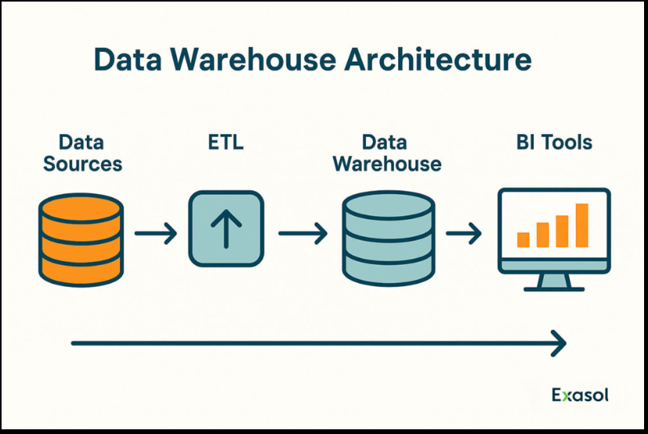
System Architecture
Figure: End-to-end system architecture. Raw operational data (ERP/CSV/etc.) is fed into a Python-driven ETL layer that performs extraction, cleansing, and transformation. The clean data is loaded into a SQL Server-based enterprise data warehouse (star-schema design). Finally, BI tools (Power BI dashboards) connect to the warehouse to deliver analytics to users. In the architecture, the ETL stage implements data integration tasks (cleansing, normalization), and Power BI queries the star-schema tables to visualize trends and KPIs. This separation ensures that complex analytics do not impact transactional systems.

Slide 9
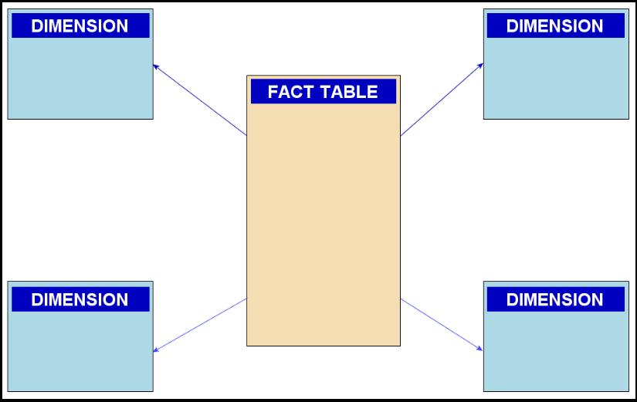
Star Schema Design
Figure: Data warehouse star schema. A single FactSales table at the center stores quantitative measures (e.g. TotalAmount, Quantity, Country) and foreign keys to dimensions. Surrounding it are dimension tables such as DimCustomers, DimProducts, and DimTime holding descriptive attributes (customer demographics, product details, calendar info). In a star schema, dimension tables are used for filtering/grouping and fact tables enable aggregation. For example, FactSales might have columns (TimeKey, CustomerKey, ProductKey, Quantity, UnitPrice, TotalAmount), while dimensions hold the context (e.g. customer name, product category, date). This design supports fast summary queries and is widely recommended for Power BI models.

Slide 10
Sample Outputs: Fact and Dimension Tables
Fact Table (FactSales): Stores all sales transactions at key-level grain. Example schema:
FactSales(SalesKey, TimeKey, CustomerKey, ProductKey, Quantity, UnitPrice, TotalAmount, Country). This fact table links to dimensions via TimeKey, CustomerKey, etc.
Dimension Tables: Hold descriptive data. E.g. DimCustomers(CustomerKey, CustomerID, FirstPurchaseDate, TotalOrders, TotalSpent) stores each customer’s profile. DimProducts(ProductKey, StockCode, Category, Description) holds product info, and DimTime(TimeKey, FullDate, Day, Month, Year, …) provides calendar attributes.
ETL Results: After running the Python ETL scripts, the staging table is cleaned and loaded into these target tables. (A stored procedure might remove bad rows and uppercase text, then report the number of rows loaded.) The cleaned data is now query-ready in the star schema.

Slide 11
Sample Outputs: Dashboard
Figure: Sample Power BI sales dashboard. This dashboard (mockup) displays a sales funnel visual and KPIs. The funnel chart highlights conversion rates at each stage (e.g. leads → opportunities → closed deals). Other charts show metrics like total won amount by region or by sales rep. Such dashboards allow slicing by filters (date, region, etc.) and make it easy to “view the sales funnel with conversion rates at each stage to identify bottlenecks” and to “track won and lost deals by reason and owner”. These insights help management spot trends and performance issues interactively.

Slide 12
References
M. Faridi Masouleh et al., “Optimization of ETL Process in Data Warehouse Through a Combination of Parallelization and Shared Cache Memory,” Eng. Technol. Appl. Sci. Res., vol. 6, no. 6, pp. 1241–1244, Dec. 2016.
IEEE Research on Enterprise ETL and Data Warehousing
William H. Inmon – Building the Data Warehouse
R. Kimball and M. Ross, The Data Warehouse Toolkit, 3rd ed., Wiley, 2013.
Microsoft, “Hardware and software requirements for SQL Server 2022,” Documentation (2022).
Microsoft Learn, “Star schema overview and design” (Power BI guidance).
Python Software Foundation, Python 3.x Documentation (python.org).
Additional sources: Salesforce data warehouse insights, Medium data engineering project, etc.

Slide 13
Thank You
Any Questions?

